Slide 1
DATA VISUALIZATION
09.04.2022

Slide 2
DYNAMIC DATA
Flow visualization is the study of methods to display dynamic behaviour in liquids and gases.
Since then, laboratory flow visualization has become more and more exact, with careful control of the particulate size and distribution.
Advances in photography has also helped extend our understanding of how fluids flow under various circumstances.

Slide 3
CONTD.
More recently, computational fluid dynamics (CFD) has extended the abilities of scientists to study flow by creating simulations of dynamic behaviour of fluids under a wide range of conditions.
The result of this analysis is usually a 2D or 3D grid of velocity vectors, which may be uniformly or non uniformly spaced.
The goal is then to analyse this vector field to identify features such as turbulence, vortices, saddle points, and other forms of structure.

Slide 4
CONTD.
There are several variations on the structure of the field data that is generated by these experiments. A static field is one in which there is only a single, unchanging velocity field.
Time-varying fields may either have fixed positions with changing vector values or both changing positions and changing vectors (for example, when modelling rotating turbine blades or pitching air foils). These latter types are referred to as unsteady.

Slide 5
STANDARD DEFINITIONS IN DYNAMIC DATA
Pathline—The trajectory of a particle released into a flow field; it assumes multiple time instances. In experimental visualization, this can be achieved by long-term film exposure.
Streakline—Simultaneous positions of a set of particles continuously released from one or more locations.
Timeline—Position at any instant of time of a batch of particles that have been released simultaneously.
Streamline—A line through the velocity field that is tangent to the velocity field at every point.

Slide 6
COMBINING TECHNIQUES
Many effective visualizations are actually combinations of two or more of the techniques described above.
Each technique has its strengths and weaknesses in terms of the types of information it can or cannot effectively visualize, so a combined visualization, as long as occlusion is minimized, can generate results that are the sum of the strengths.
At the same time, more and more problems require the simultaneous analysis of multiple data sets to arrive at an informed result.
For example, weather forecasting involves the combination of air and surface temperature, wind speed, relative humidity, and a number of other factors to develop an accurate prediction.

Slide 7
SLICE + ISO SURFACES
An isosurface from a medical data set is combined with an orthogonal slicing of the same data set, mapping the isosurface to one color and the values in the image resulting from the slice mapped to a separate color ramp.
The isosurface is capable of conveying surface structure, which is difficult to obtain from volume slicing, even with animation of the slice position.
However, the isosurface only provides information on a single value within the entire volume, with no indication of the distribution of other values or the gradient (rate of change) of the selected value at different locations.

Slide 8
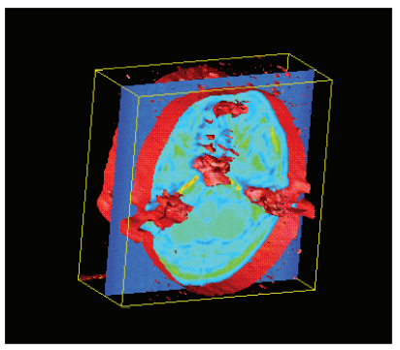
CONTD.
The slice provides very detailed two-dimensional information, especially with an appropriate choice of colour assignments.
It can convey to the user the regions of relative uniformity, as well as those exhibiting significant change.
Another advantage is that the image slice can convey nested regions of a particular value range, while the isosurface, in general, will only display the outer-most surface.

Slide 9
CONSIDERATIONS FOR ISOSURFACES+SLICE
Several considerations and capabilities are important when designing and developing this visualization:
• it is critical to support rapid and intuitive modification of the isosurface value;
• the position and orientation (along the three axes) of the slice should be easily controlled by the user, with the option for animating its position as it steps through the volume;
• camera position and orientation control are essential to enable viewing of the surface and slice from all orientations.

Slide 10
CONSIDERATIONS FOR ISOSURFACES+SLICE
• Colour assignment is crucial, as features of interest in the slice may only be revealed with a carefully chosen colour map. Similarly, we might want to choose the colour of the iso surface so that it does not appear in the colour map used for the slice, to reduce the potential for misinterpretation;
• The user should be able to easily hide either of the two visualization components to make it easier to study the remaining data display. Another option is to allow the user to control the opacity of the components, perhaps using a slider that ranges from hiding the slice entirely to hiding the iso surface.

Slide 11
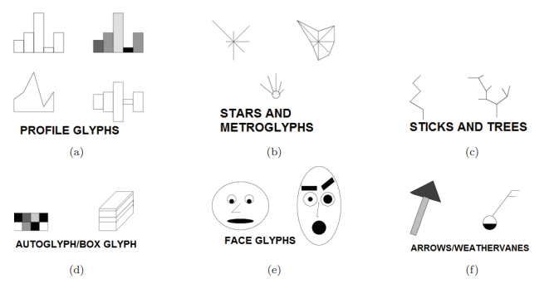
GLYPHS
A glyph is any marker, such as an arrow or similar marking, used to specify part of a visualization.
This is a representation to visualize data where the data set is presented as a collection of visual objects. These visual objects are collectively called a Glyph.

Slide 12
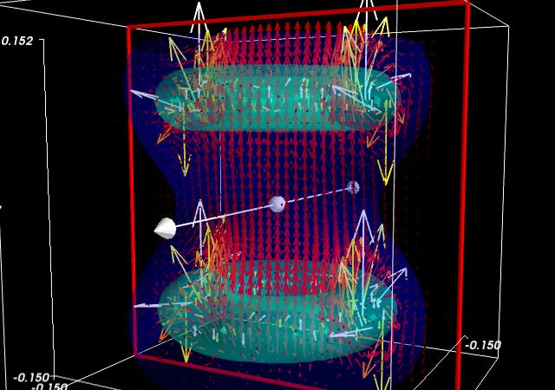
ISOSURFACES+GLYPHS
Isosurfaces are useful for conveying details of three-dimensional surfaces, but, in general, do not incorporate other aspects of the data.
Glyphs such as the popular arrow glyph, can be used to display the magnitude and direction of change within a data set, either as a gradient in static data or a flow in dynamic data.
The glyphs may be positioned in close proximity to the iso surface, since these are known to be positions of interest, or the positions may be controlled separately

